Slide 1
International Asset Pricing with Strategic Business Groups
Massimo Massa INSEAD, 1 Ayer Rajah Avenue, Singapore 138676, Singapore
James O’Donovan City University of Hong Kong, Hong Kong
Hong Zhang Tsinghua University, PBC School of Finance, China
Presented by Austin Francis

Slide 2
Research Question
The paper investigates how the strategic behavior of business groups, specifically their ability to reallocate risk across affiliated firms, affects international asset pricing.

Slide 3
Prior Literature
Business Groups and Asset Allocation: Prior research suggests business groups can manage risk internally through capital markets (e.g., Stein, 1997; Johnson et al., 2000; Bertrand et al., 2002). Groups are able to shift assets and risks across firms, centralizing control in key companies.Asset
Pricing Models: Traditional asset pricing models assume independence among firms, which is more applicable to U.S.-listed firms (Claessens et al., 2000; Faccio and Lang, 2002). This fails to account for business groups prevalent in international markets.

Slide 4
Prior Literature
Strategic Risk Reallocation: Studies suggest that during bad times, business groups protect their most critical (central) firms to maintain control (Almeida and Wolfenzon, 2006; Jiang et al., 2010). This behavior leads to systematic differences in risk profiles across affiliated firms.
New Risk Factors in Asset Pricing: Merton's (1973) intertemporal asset pricing model proposes that investors may want to hedge against unfavorable shifts in risk. This can lead to the creation of new risk factors, such as those arising from the strategic reallocation of risk within business groups.

Slide 5
Hypothesis
Central firms in business groups are protected in bad times through the strategic reallocation of resources and risk, leading to lower risk exposure and lower expected returns compared to peripheral firms.

Slide 6
Key Metrics
Centrality: Measures the importance of a firm within a business group, i.e., the degree to which losing control of the firm affects the group’s control over total assets.
Unexpected Shocks: Negative industry or sovereign downgrade shocks to assess how central firms are protected.
Stock Returns: Out-of-sample stock returns adjusted for size, book-to-market, and momentum.
Intertemporal Risk Factor: A central minus peripheral mimicking portfolio that captures the strategic behavior of business groups.

Slide 7
Results
Central Firms Are Protected: Central firms are less affected by negative shocks compared to peripheral firms, confirming the hypothesis that business groups strategically protect these key firms in bad times.
Lower Expected Returns for Central Firms: Central firms earn lower expected returns, even after controlling for size, book-to-market, and momentum, due to their lower risk exposure.
New Risk Factor in Asset Pricing: The centrality-based factor adds explanatory power to traditional asset pricing models, suggesting that the strategic behavior of business groups introduces an additional risk factor in international markets

Slide 8
Data Collection
Orbis database
Ownership data on 150,343 unique international firms

Slide 9
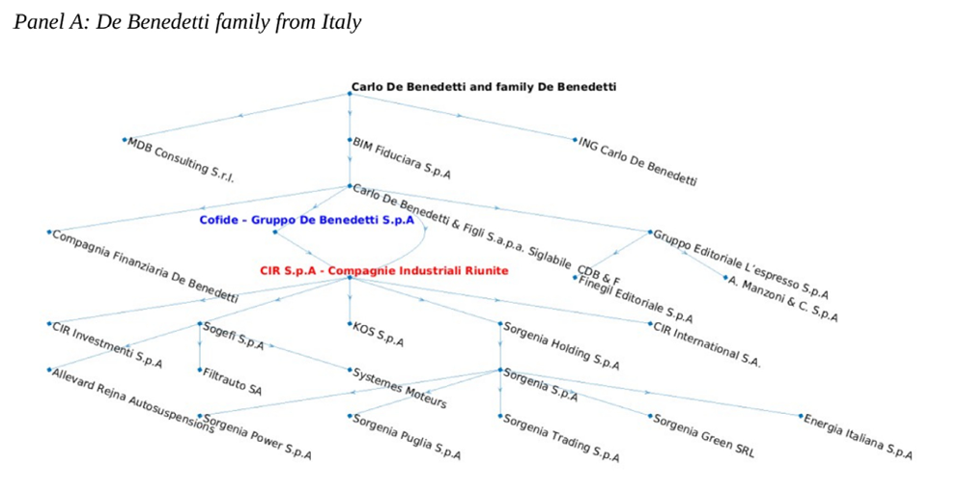

Slide 10
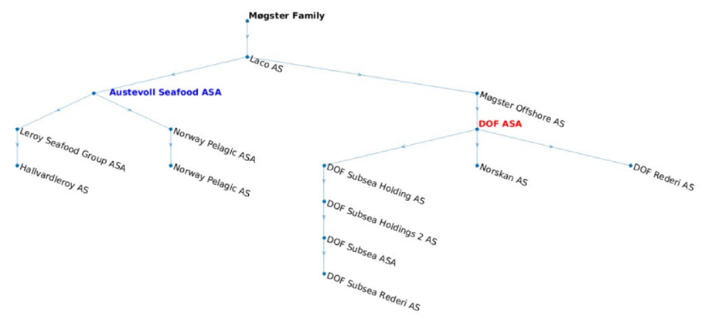

Slide 11
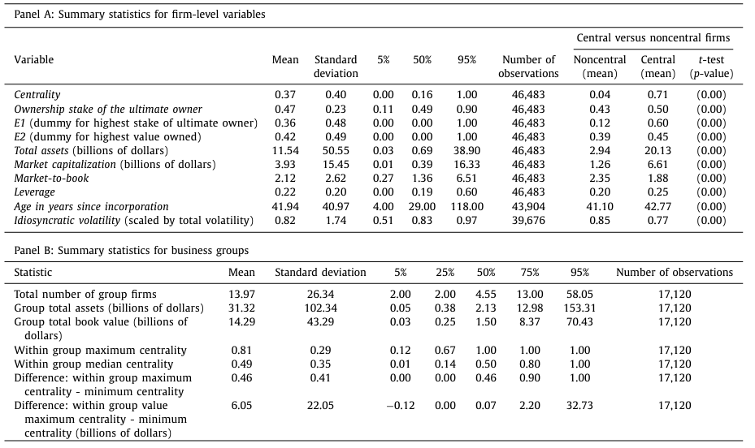
Table 1 –
Notes:
Key Takeaways:
Central firms are larger and more valuable than non-central firms.
Centrality: The mean centrality for the central firms is 0.71 compared to 0.04 for non-central firms.
Total Assets: Central firms average $20.13 billion, while non-central firms average only $2.94 billion.
Ownership is more concentrated in central firms.
Ownership stake of ultimate owner: Central firms have an average ownership stake of 50%, while non-central firms average 43%.
Older firms tend to be central.
Age of firms: Central firms average 42.77 years since incorporation, while non-central firms average 41.10 years. What it shows simply: This table highlights that central firms, often larger, more valuable, and older, are crucial to the structure of business groups and show distinct differences in characteristics from non-central firms.

Slide 12
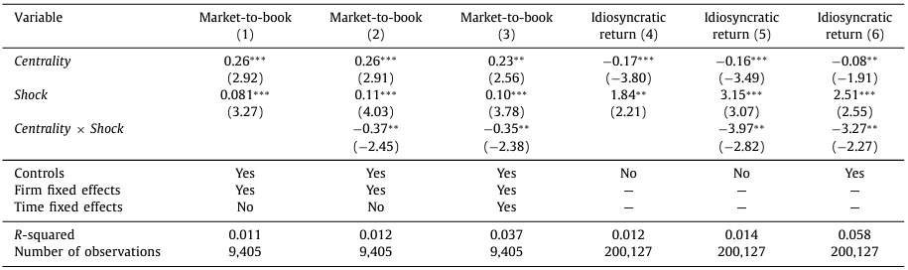
Table 2 – Sensitivity to shocks
Notes:
Dependent variable: What it proves: This table shows how unexpected industry shocks affect firm valuation and returns, highlighting the impact of centrality. It compares the market-to-book ratio and idiosyncratic returns of central vs. non-central firms during negative industry and commodity shocks.
Key Takeaways:
Central firms are better protected from industry shocks.
Centrality × Shock: The interaction term has a significantly negative coefficient of -0.37 in Model 1, meaning central firms are less sensitive to negative shocks.
A one standard deviation increase in centrality offsets about 12% of the negative impact of an industry shock.
Central firms show lower sensitivity to commodity shocks as well.
Idiosyncratic returns: The interaction of centrality with commodity shocks in Model 5 shows that a one standard deviation increase in centrality offsets about 32% of the negative impact.
The strategic position of central firms mitigates the adverse effects of both types of shocks.
The results indicate central firms are insulated from negative shocks, as their business group status provides them a protective buffer, evidenced by significant negative coefficients on interaction terms.
What it shows simply: This table demonstrates that central firms within business groups are shielded from economic downturns or shocks, making them more resilient than non-central firms.

Slide 13
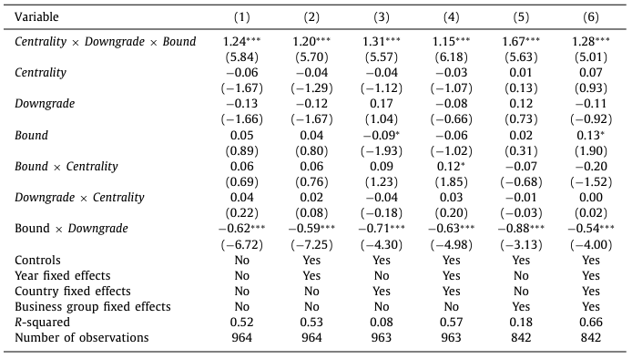
Table 3 – Exogenous Sovereign Downgrades
Notes:
Annual stock returns (in percentage) are the dependent variable What it proves: This table shows how central firms react to exogenous sovereign downgrades and compares their resilience to non-central firms.
Key Takeaways:
Central firms are shielded from the negative impact of sovereign downgrades.
The interaction term Centrality × Downgrade × Bound has a positive coefficient (1.24 to 1.67 across models), meaning central firms face significantly less negative returns than non-central firms during downgrades.
Central firms exhibit strategic insulation.
The protection is strong: a 90% reduction in the negative price impact for highly central firms is observed in the full model with all controls.
Downgraded countries see a lower impact on central firms.
The results highlight how business groups may use centrality to protect core assets even under severe external shocks like sovereign downgrades.
What it shows simply: Central firms are insulated by their strategic importance within business groups, shielding them from market downturns caused by sovereign credit downgrades.

Slide 14
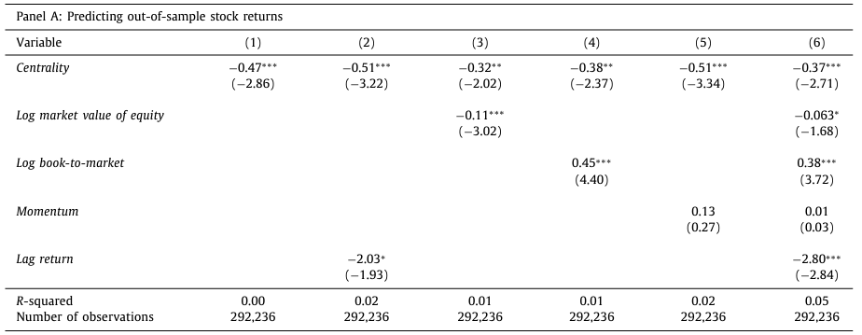
Table 4 - Return Predictability of Centrality in Fama-MacBeth Regressions
Notes:
Raw stock returns (Panel A) and DGTW-adjusted stock returns (Panel B) are the dependent variables. What it proves: This table explores how centrality predicts stock returns by running Fama-MacBeth regressions, revealing whether centrality has a significant impact on stock performance.
Key Takeaways:
Higher centrality leads to lower stock returns.
Across all models, centrality consistently shows a negative relation with returns (e.g., -0.51 in Model 2), suggesting central firms underperform in terms of excess returns.
Size and value matter.
Firms with higher book-to-market ratios have higher returns (0.38 to 0.45), while firms with larger market values have lower returns (-0.11 to -0.06).
Lagged returns show negative momentum.
Firms that performed well in the past show negative future returns, suggesting a reversal pattern in central firms.

Slide 15
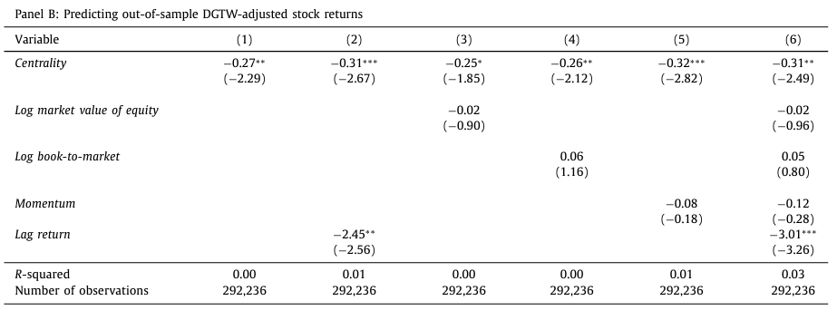
Table 4 - Return Predictability of Centrality in Fama-MacBeth Regressions
Notes:
What it proves: This table explores how centrality predicts stock returns by running Fama-MacBeth regressions, revealing whether centrality has a significant impact on stock performance.
Key Takeaways:
Higher centrality leads to lower stock returns.
Across all models, centrality consistently shows a negative relation with returns (e.g., -0.51 in Model 2), suggesting central firms underperform in terms of excess returns.
Size and value matter.
Firms with higher book-to-market ratios have higher returns (0.38 to 0.45), while firms with larger market values have lower returns (-0.11 to -0.06).
Lagged returns show negative momentum.
Firms that performed well in the past show negative future returns, suggesting a reversal pattern in central firms.

Slide 16
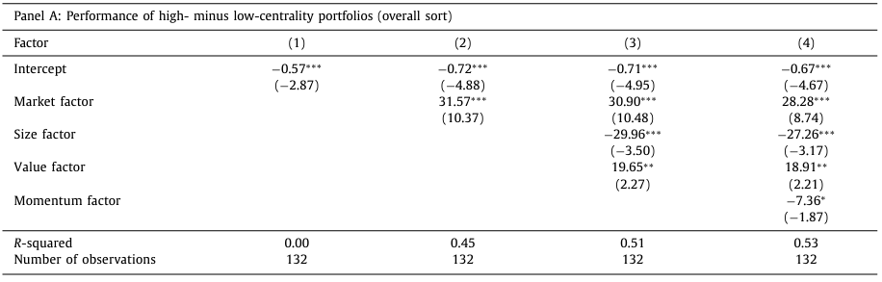
Table 5 – Portfolio Analysis
Notes:
The risk-adjusted portfolio returns (sorted by centrality) are the dependent variable This table presents the performance of portfolios composed of central and non-central firms, highlighting the relative returns between them.
Key Takeaways:
Low-centrality firms outperform high-centrality firms.
In all specifications, high-minus-low centrality portfolios deliver negative returns (e.g., -0.72 in Model 2), indicating that low-centrality firms outperform.
Market risk dominates.
The market factor is highly significant and positive across models, contributing the most to portfolio returns (31.57 in Model 1).
Size and value factors are significant.
The size factor is negatively associated with returns (-29.96 in Model 1), while the value factor is positively related to returns (19.65 in Model 1).
What it shows simply: Firms with lower centrality generate better portfolio returns, likely because higher centrality firms are more conservative and less volatile.

Slide 17
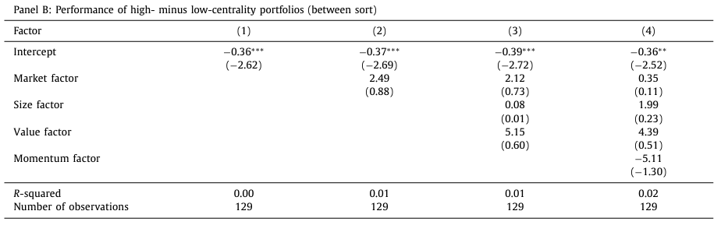
Table 5 – Portfolio Analysis

Slide 18
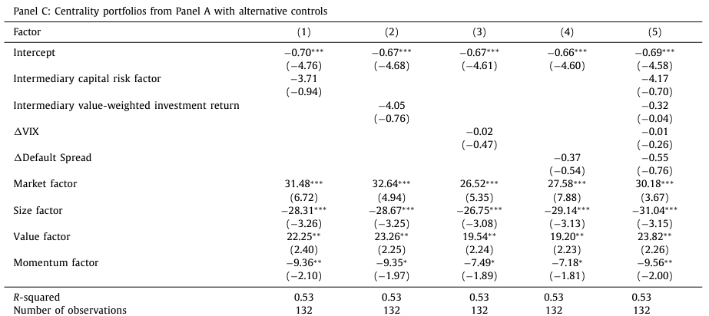
Table 5 – Portfolio Analysis
Notes:
Robustness check

Slide 19
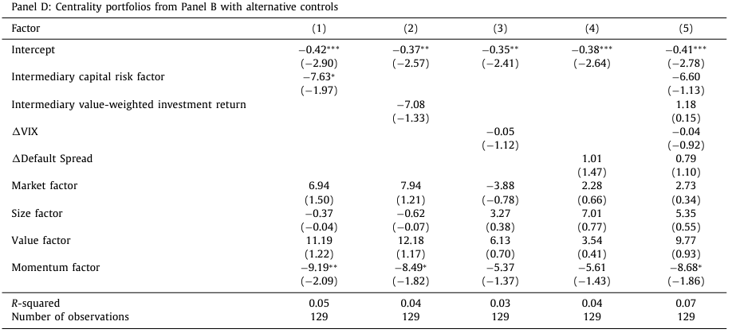
Table 5 – Portfolio Analysis

Slide 20
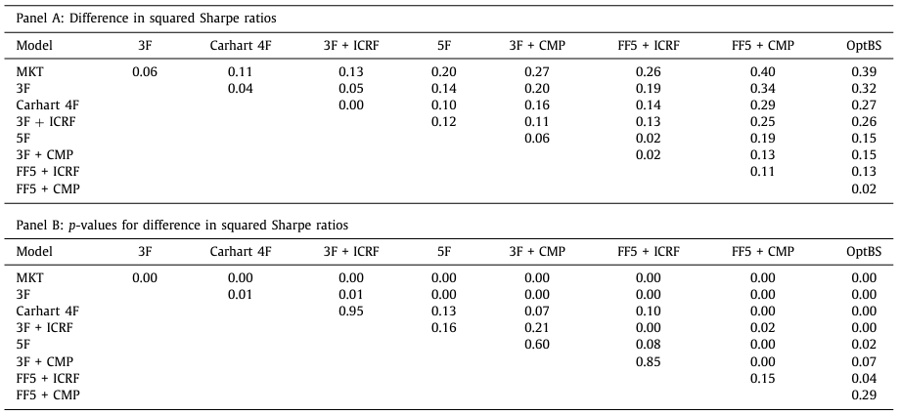
Table 6 – Model Comparisons
Notes:
This table compares the Sharpe ratios of different asset pricing models with and without the centrality factor, demonstrating that adding centrality improves risk-adjusted performance.
Key Takeaways:
Centrality factor enhances portfolio performance.
Squared Sharpe Ratio: Adding centrality to a Fama-French 3-factor model increases the squared Sharpe ratio by 0.02 (Model 3F vs. 3F + CMP), showing improved risk-adjusted returns.
Statistically significant improvements.
P-values: The improvement in the squared Sharpe ratio is statistically significant at the 5% level, with p-values of 0.00 for most comparisons, demonstrating that models with centrality outperform.
Robust across various models.
Model Comparisons: Across the CAPM, Fama-French, and Carhart models, adding centrality consistently improves performance, reinforcing that centrality is a significant risk factor.
What it shows simply: This table highlights that including the centrality factor in asset pricing models improves their performance, as measured by the Sharpe ratio, indicating better risk-adjusted returns. CMP and ICRF refer to specific factors used in the asset pricing models being tested.
CMP (Central Minus Peripheral):
CMP is a centrality-based factor created by forming a mimicking portfolio of central firms versus peripheral firms. It is similar in concept to traditional factors like the market, size, or value factors in asset pricing models (e.g., the SMB factor for size). The CMP factor represents the difference in returns between central firms (which are more important in business groups) and peripheral firms (less important), and it's used to capture the effect of centrality on stock returns.
ICRF (Intertemporal Centrality Risk Factor):
ICRF is an intertemporal risk factor associated with centrality, based on the idea that central firms face different risk dynamics over time compared to peripheral firms. It builds on the notion from Merton's Intertemporal Capital Asset Pricing Model (ICAPM), where long-term investors hedge against changes in their investment opportunities. The ICRF represents risks that arise due to the strategic behavior of business groups in reallocating risk between central and peripheral firms over time.
In short, CMP and ICRF are both factors designed to capture the influence of centrality on asset returns, but CMP is a cross-sectional factor, while ICRF is an intertemporal risk factor.

Slide 21
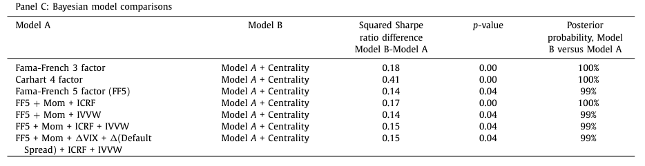
Table 6 – Model Comparisons

Slide 22
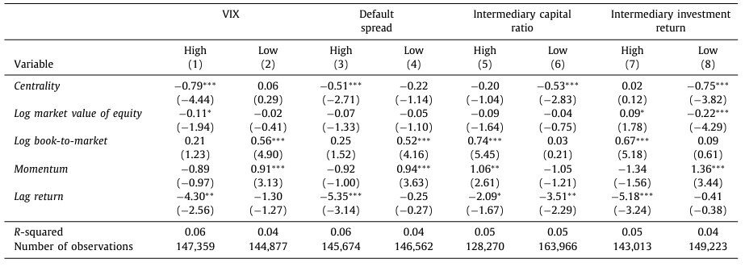
Table 7 - Robustness Checks
Notes:
The stock returns (monthly or annual, depending on the specific model) are the dependent variable. The table explores how central firms perform under different states of economic uncertainty (e.g., high VIX, high default spreads). This table examines the relationship between centrality and stock returns across different states of the economy, showing that central firms perform differently based on economic conditions.
Key Takeaways:
Higher centrality firms perform worse during periods of high uncertainty.
Coefficient: Centrality is negatively associated with returns during high VIX periods (-0.79), indicating central firms are more vulnerable to economic uncertainty.
Mixed performance in different economic states.
Default Spread: In high default spread periods, central firms have a lower return (-0.51), but the effect is less severe compared to VIX periods.
In low uncertainty, centrality has less influence.
Low Uncertainty Periods: The coefficients for centrality during low VIX and low default spread periods are not statistically significant, suggesting that centrality matters most during crises.
What it shows simply: This table demonstrates that central firms are more vulnerable during economic downturns, but in stable periods, their centrality has less impact on returns.

Slide 23
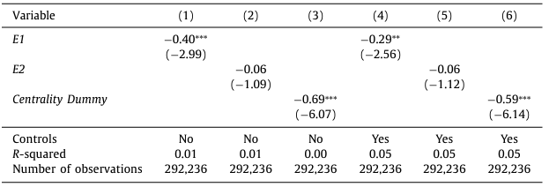
Table 8 - Alternative Measures
Notes:
The stock returns (raw and adjusted) are the dependent variable. E1 (Dummy for Highest Stake of Ultimate Owner):
E1 is a dummy variable that equals 1 if the firm has the highest ownership stake by the ultimate owner within the business group, and 0 otherwise. It is used to identify the firm in the group where the ultimate owner holds the most significant direct ownership stake. This measure is commonly used to represent the firm that plays a crucial role in control, since it has the highest direct ownership.
E2 (Dummy for Highest Value of Owned Cash Flow Rights):
E2 is a dummy variable that equals 1 if the firm has the highest cash flow rights within the business group, and 0 otherwise. This means that E2 identifies the firm in the group where the ultimate owner is entitled to the largest share of the group's cash flows. It reflects the separation of control and cash flow rights, which can occur when the firm with the highest control (E1) is not necessarily the firm receiving the most cash flows.
In summary, E1 is focused on ownership control, while E2 is centered on cash flow entitlements. Both E1 and E2 are used in robustness tests to see how different aspects of centrality (control vs. cash flows) affect stock performance.
This table explores alternative ways to measure centrality and their impact on returns, showing that central firms consistently have lower returns across different metrics.
Key Takeaways:
Firms with the highest stake of ultimate owners perform worse.
Coefficient: Firms with the highest ownership stake (E1) have significantly lower returns (-0.40), suggesting a strong negative relationship between ownership concentration and performance.
Cash flow rights and returns show a weaker link.
Coefficient: The impact of cash flow rights (E2) on returns is smaller (-0.06) and not significant, indicating this measure has less predictive power than ownership stakes.
Consistent findings across centrality measures.
Centrality Dummy: The centrality dummy variable is also negatively related to returns, confirming the robustness of the centrality-return relationship across different definitions.
What it shows simply: Different ways to measure centrality (ownership stake, cash flow rights) consistently show that central firms have lower returns, reinforcing the negative impact of centrality on performance.

Slide 24
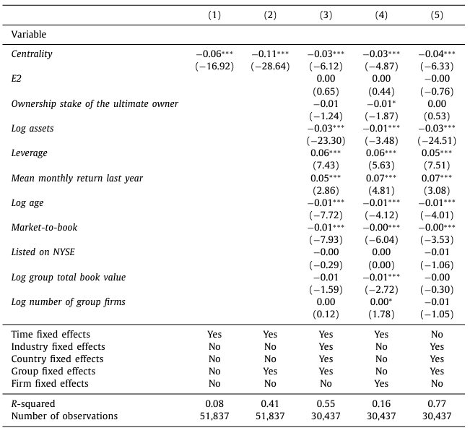
Table 9 - Centrality and Alternative Risk Factors
Notes:
Dependent Variable: The idiosyncratic volatility of firms is the dependent variable. The table examines the relationship between centrality and the amount of firm-specific risk (volatility not explained by market movements). This table tests the relationship between centrality and idiosyncratic risk, showing that more central firms tend to have lower idiosyncratic volatility.
Key Takeaways:
Central firms have lower idiosyncratic risk.
Coefficient: Centrality is negatively associated with idiosyncratic volatility (-0.03), indicating that more central firms experience less firm-specific risk.
Economic significance of the effect.
Impact: A one standard deviation increase in centrality results in a 0.01 decrease in idiosyncratic volatility, which is economically significant, reducing risk by about 0.1 standard deviations.
Robust findings across models.
Various Controls: The negative relationship between centrality and idiosyncratic volatility holds across different model specifications, showing the robustness of the results.
What it shows simply: This table demonstrates that central firms have lower idiosyncratic risk, meaning they are less exposed to firm-specific shocks, likely due to strategic risk reallocation within business groups.

Slide 25
Conclusion
Central firms are strategically protected within business groups, especially during bad economic times.
Central firms consistently earn lower returns compared to non-central firms.
The centrality factor (CMP) is a significant addition to traditional asset pricing models.
Notes:
Central firms are strategically protected within business groups, especially during bad economic times.
Central firms (those critical to group control) are better shielded from negative economic shocks, such as industry downturns or sovereign downgrades. For example, a one standard deviation increase in centrality offsets about 12% of the negative impact of industry shocks and 90% of the negative impact of sovereign downgrades. This strategic risk reallocation protects these firms, while peripheral firms bear more risk.
Central firms consistently earn lower returns compared to non-central firms.
The paper finds that central firms have lower expected stock returns than peripheral firms, despite being better protected from risk. For instance, a one standard deviation increase in centrality is associated with a 14 basis points lower monthly return (DGTW-adjusted). This suggests that the market prices in the protection given to central firms, leading to a lower risk premium.
The centrality factor (CMP) is a significant addition to traditional asset pricing models.
The introduction of the Central Minus Peripheral (CMP) factor significantly improves the explanatory power of traditional models like the Fama-French 3-factor or Carhart 4-factor models. The CMP factor captures the unique risks and return dynamics of central firms in business groups, and adding it increases the Sharpe ratio and overall model performance. This demonstrates that traditional asset pricing models, which don't account for strategic business groups, are incomplete.
These findings collectively highlight the critical role of business group structure and strategic centrality in shaping risk, returns, and asset pricing in international markets.

